Slide 1

What is the name of the this shape?
Looks like a rectangle leaning over
Think Pair Share
Notes:
Think pair share activity

Slide 2
It’s a Parallelogram
The arrows show which sides are parallel

Slide 3
24
7
30
Date
Area of Parallelograms
EQ – How can we calculate the area of parallelograms?
Counting squares
The number of squares inside the rectangle is the area, but not all are full squares.
5

Slide 4
Estimate the area of the following.
2 square units
8 square units

Slide 5
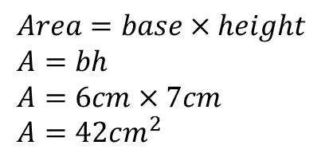
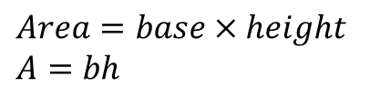
24
7
30
Area of Parallelograms
EQ – How can we calculate the area parallelograms?
$$Area=base×height \\ A=bh$$
Area formula
height
$$Area=base×height \\ A=bh \\ A=6cm×7cm \\ A=42cm^{2}$$
6cm
base
7cm

Slide 6


Find the area
$$Area=base×height \\ A=bh \\ A=3cm×5cm \\ A=15cm^{2}$$
3cm
5cm
4.5cm
$$Area=base×height \\ A=bh \\ A=10cm×4.5cm \\ A=45cm^{2}$$
10cm

Slide 7
Practice
Complete exercise 2.6
Page 23

Slide 8
10 quick Questions
Notes:
If you need to program see Adam before your lesson. It is on the share drive.

